Slide 1


Interpretable Neural network driven by quantum probability theory
Benyou Wang, Qiuchi Li, Prayag Tiwari, Massimo Melucci
University of Padova
18/sep/2018

Slide 2
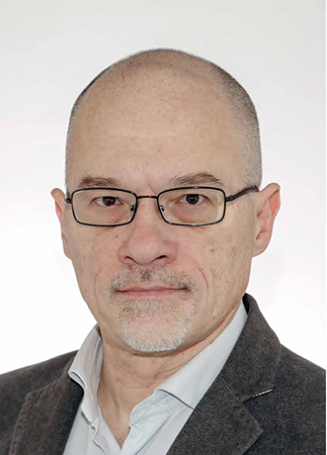


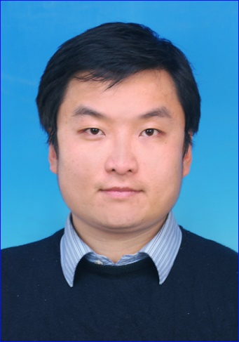
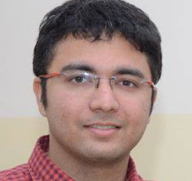
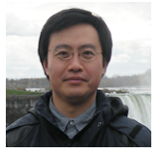
Done with the collaboration

Slide 3
Contents
Motivation: Interpretability in end2end network
Method: Hilbert Semantic Space
Applications: language representation and matching
Text classification
Matching with question answering

Slide 4

End-to-end Paradigm
https://www.youtube.com/watch?v=TYpBJ71VW9g

Slide 5
An Pipeline example for text processing
tokenizering
stemming
query
Removing stopwords
Rerank
Prerank
Parsing
Combine multiple results from different sources
Filter some contents if necessary
documents

Slide 6
End to end mechanism
Less accumulating error
Less involvement with Human beings
Improve performance with shared features of the downstream tasks and upstream tasks
Hard to adjust
Hard to transfer
Hard to understand
We need End to End mechanism, but in a fine-grained way

Slide 7
What is Interpretability
Post-hoc explanations
Take a learned model and draw some kind of useful insights
E.g. Visualization in machine translation [Liu Yang &Maosong Sun ACL 2017]
Transparency
Targeting ``how does the model work?'' and seeks to provide some way to understand the core mechanisms
E.g. Capsule Network [Hinton NIPS 2017]
Zachary C Lipton. The mythos of model interpretability. arXiv preprint arXiv:1606.03490, 2016， ICML Workshop on Human Interpretability in Machine Learning
Yanzhuo Ding, Yang Liu, Huanbo Luan, and Maosong Sun. Visualizing and understanding neural machine translation. ACL, volume 1, pages 1150–1159, 2017.
Sabour S, Frosst N, Hinton G E. Dynamic routing between capsules[C]//NIPS . 2017: 3856-3866.

Slide 8
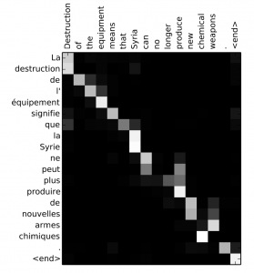
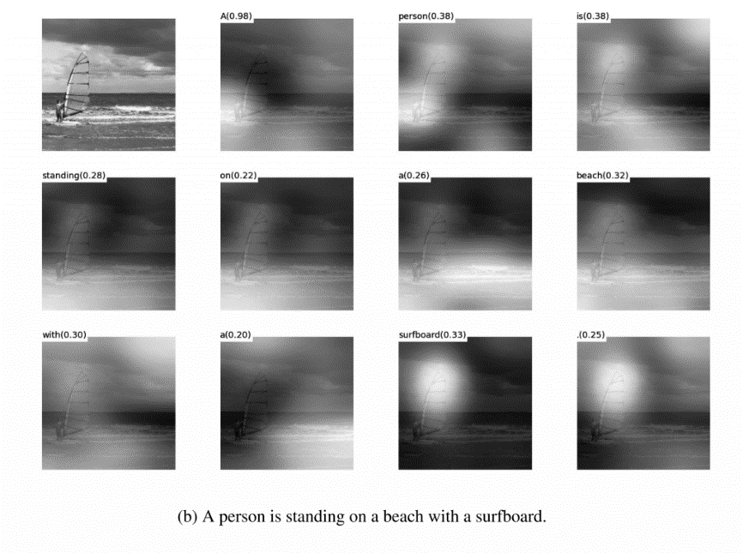
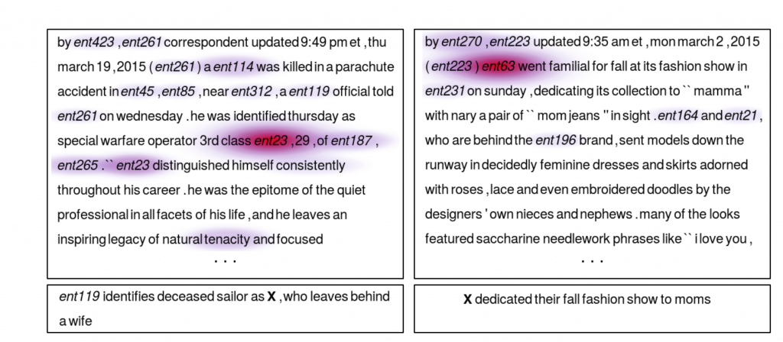
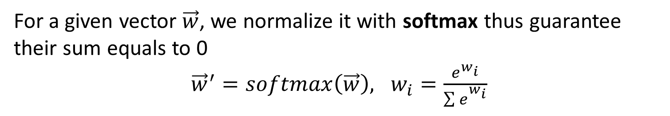
Interpretability: Attention
For a given vector $\vec{w}$, we normalize it with softmax thus guarantee their sum equals to 0
${\vec{w}}^{′}=softmax\left(\vec{w}\right), w_{i}=\frac{e^{w_{i}}}{\sum{e_{}^{w_{i}}}}$

Slide 9
Design each subcomponents in the End-2-end architecture with a good background of the task
Both language understanding and artificial intelligence require being able to understand bigger things from knowing about smaller parts
Christopher Manning 2017

Slide 10
Motivations
Design self-explainable subcomponents in end2end network
Provides more transparency as well as Post-hoc explanations
Theoretically-sound network

Slide 11
Related works
End to End language model for QA [AAAI 2018]
Quantum Many body function for language model in QA [CIKM 2018]
Quantum-inspired word Embedding [ACL REP4NLP 2018]
Hilbert Semantic Space [In process without peer review]
Text Representation
Text Matching

Slide 12
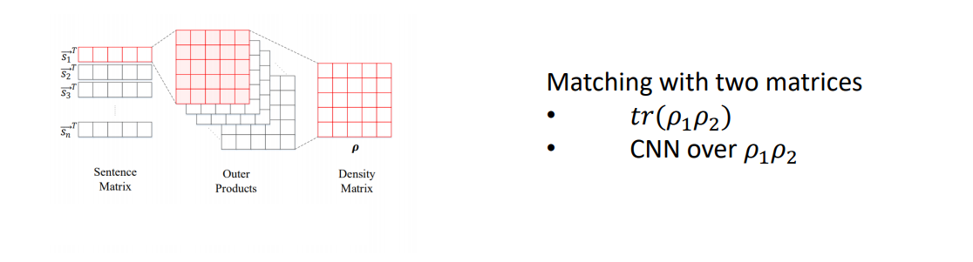
End-2-end Language model for QA
Zhang Peng, Niu Jiabing, Su Zhan, Wang Benyou et al. End-to-End Quantum-like Language Models with Application to Question Answering AAAI 2018

Slide 13
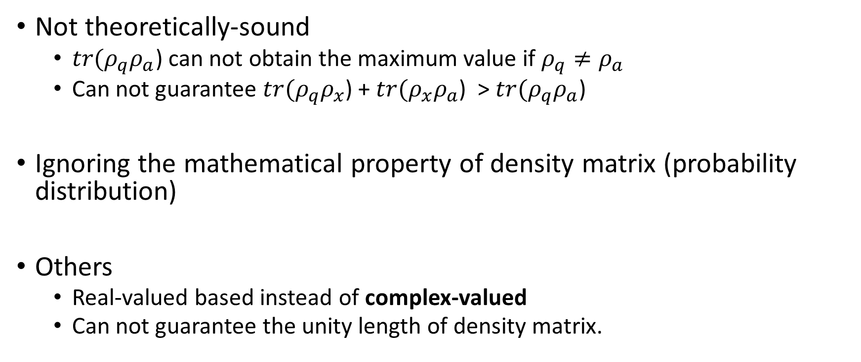
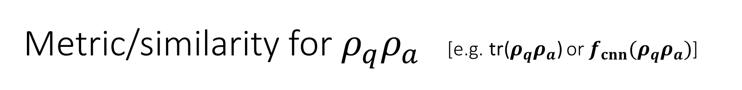
Metric/similarity for $ρ_{q}ρ_{a}$ [e.g. tr($ρ_{q}ρ_{a}$) or $f_{cnn}(ρ_{q}ρ_{a})$]
Not theoretically-sound
$tr(ρ_{q}ρ_{a}$) can not obtain the maximum value if $ρ_{q}≠ρ_{a}$
Can not guarantee $tr(ρ_{q}ρ_{x}$) + $tr(ρ_{x}ρ_{a}$) > $tr(ρ_{q}ρ_{a}$)
Ignoring the mathematical property of density matrix (probability distribution)
Others
Real-valued based instead of complex-valued
Can not guarantee the unity length of density matrix.

Slide 14
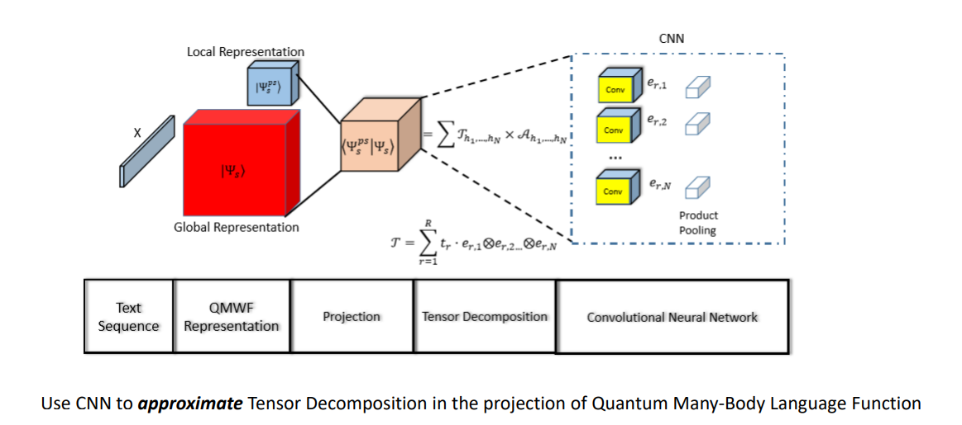
Quantum many-body function for LM
Peng Zhang, Zhan Su, Lipeng Zhang, Benyou Wang , Dawei Song. 2018. A Quantum Many-body Wave Function Inspired Language Modeling Approach, CIKM 2018

Slide 15
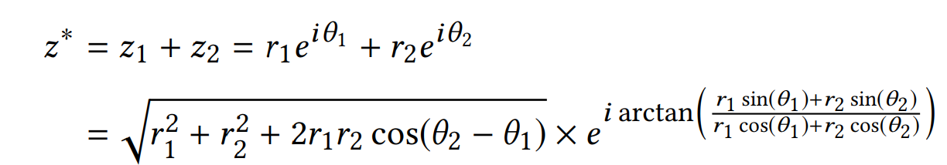
Complex word-embedding
superposition with phase
Li Qiuchi, Uprety Sagar, Wang Benyou , Song Dawei Quantum-inspired Complex Word Embedding, ACL 2018 3rd Workshop on Representation Learning for NLP , ACL 2018 RepL4NLP

Slide 16
Hilbert Semantic Space
Unify these four things in a complex-valued space
Sememes
Word
Phrase/Sentence/Documents
Topic as measurements

Slide 17
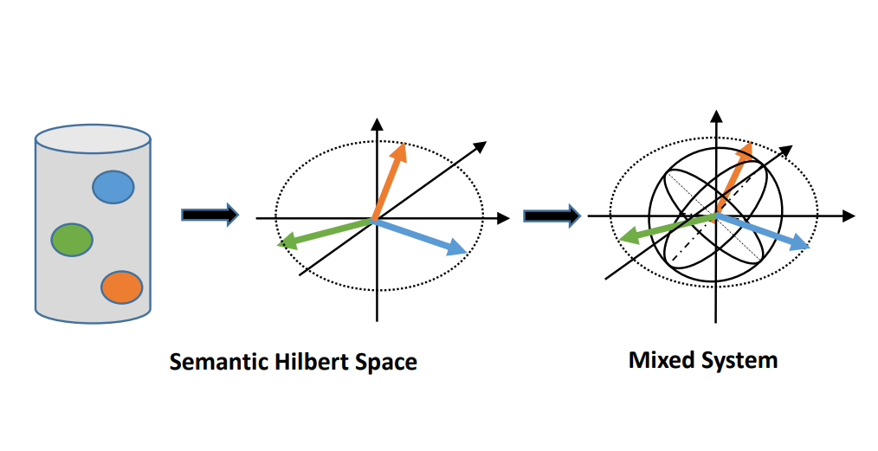
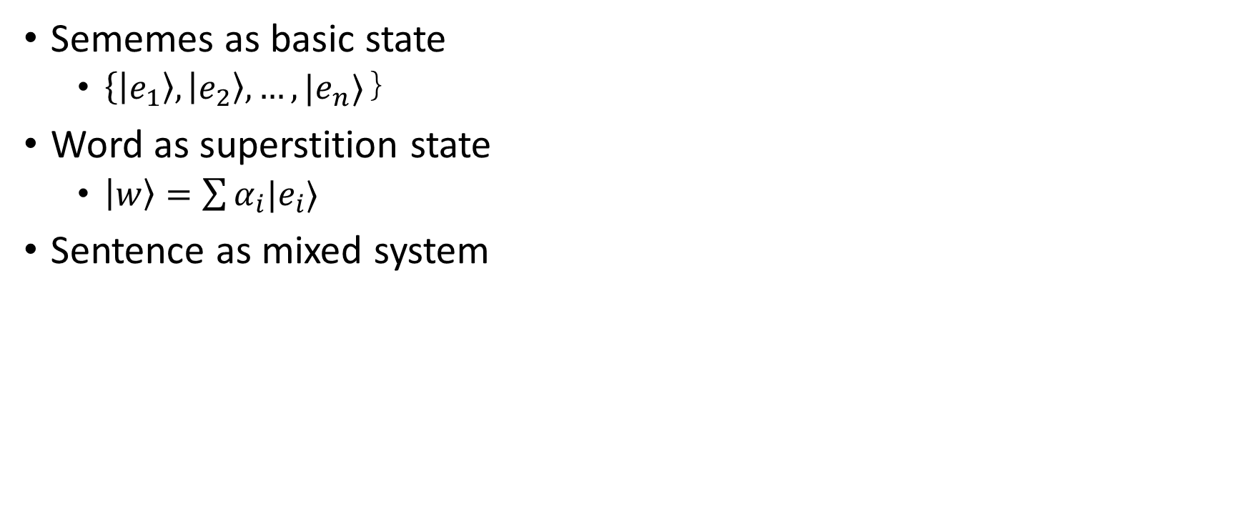
Definition
Sememes as basic state
$\left\{\left|e_{1}\right\rangle , | e_{2}\right\rangle ,…,|e_{n}⟩｝$
Word as superstition state
$\left|w\right\rangle =\sum{α_{i}|e_{i}⟩}$
Sentence as mixed system

Slide 18
Complex word embedding
Dimension: the number of
Length : weight
Amplitude part: meaning
Phase part: polarity ?
How to infer the overall polarity from the polarity of each words?
Is there any quantum phenomena here ?

Slide 19
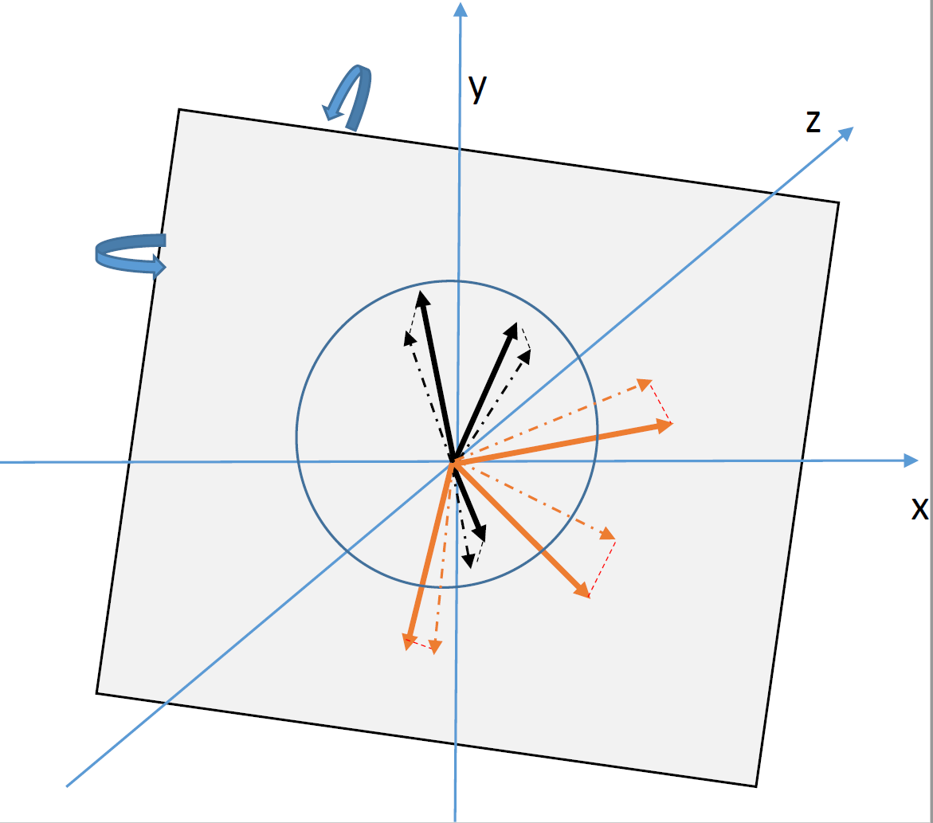
Trainable Measurements for sentence classification

Slide 20
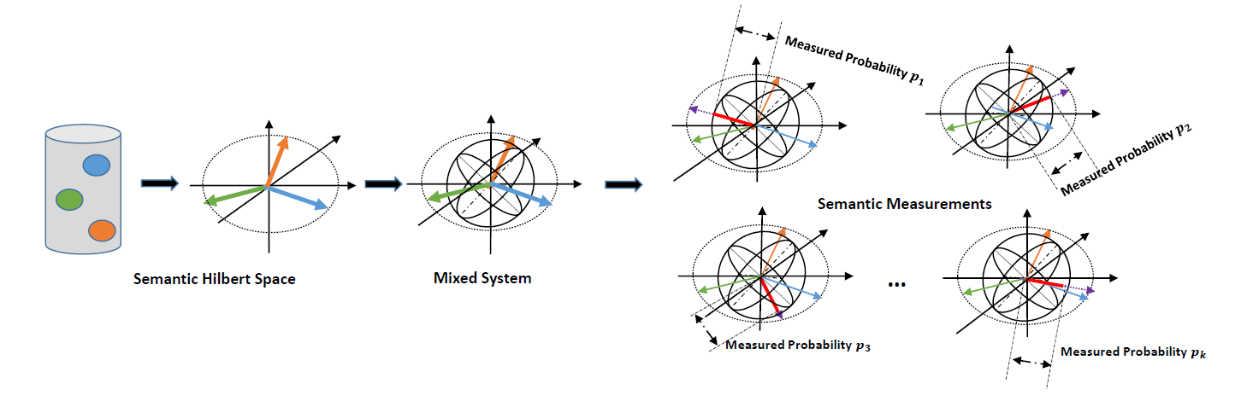
Framework

Slide 21
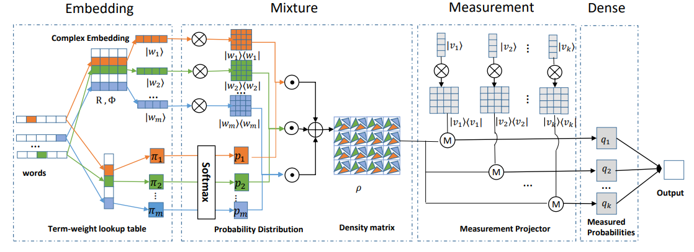
Implements
https://github.com/wabyking/qnn.git

Slide 22
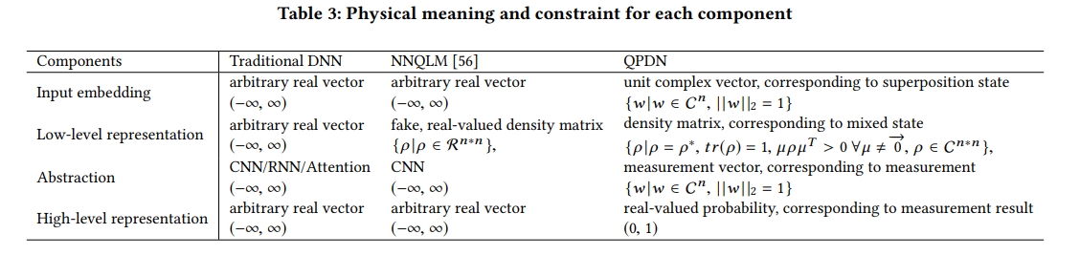
Physical meaning for our models

Slide 23
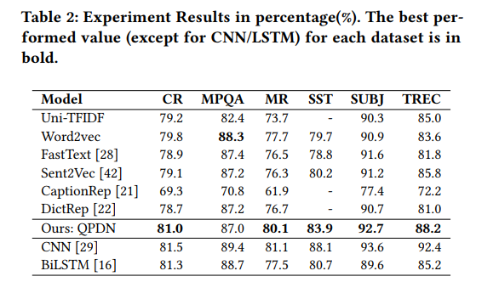
Experiments

Slide 24
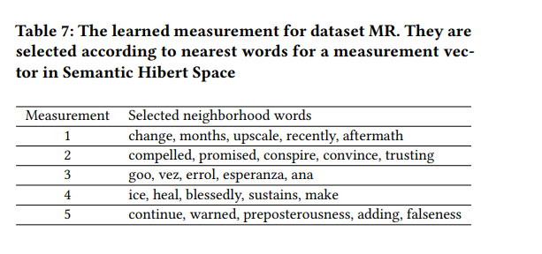
Case study for our measurement

Slide 25
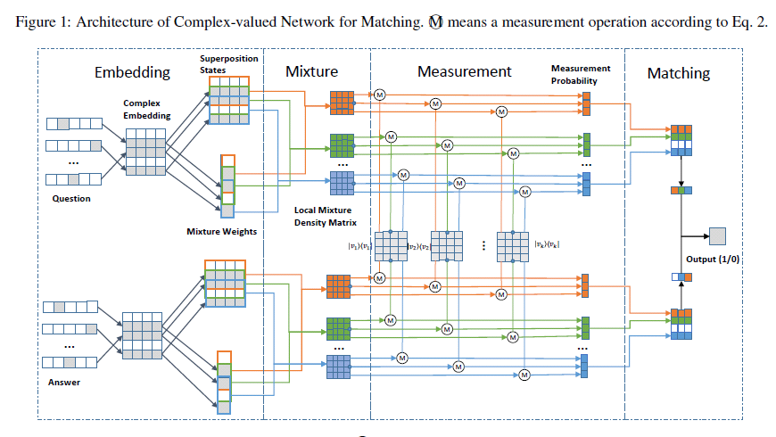
Implements for matching
https://github.com/wabyking/qnn.git

Slide 26
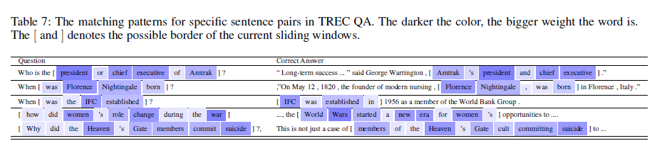
Case study

Slide 27
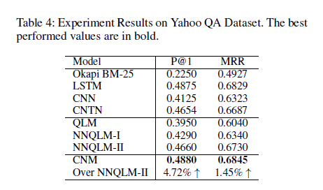
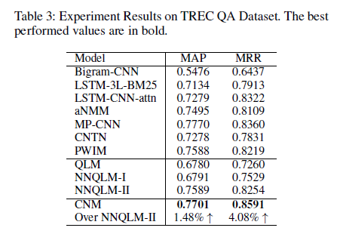
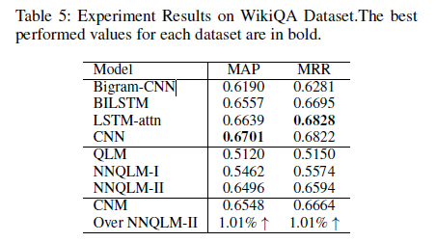
Experiments

Slide 28
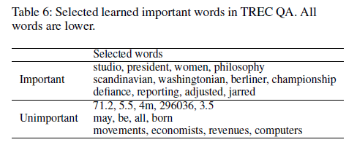
Weights

Slide 29
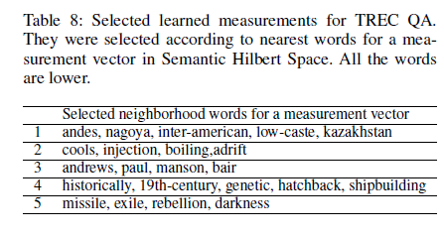
Learned measurements

Slide 30
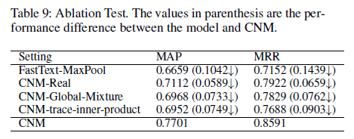
Ablation Test

Slide 31
Conclusion
More concrete physical meaning
Self-explainable subcomponents
More constrain for the subcomponents
Guided by Quantum probability theory

Slide 32
Future works
Current extension:
Incorporating more knowledge (e.g. word Polarity) in phase part
Multi-task setting to transfer learned measurement to similar tasks
New insights
Explore high-dimension tensor network with Quantum representation
Capsule Network with Quantum insights
New tasks:
Exploring generating language model with unitary transform
Quantum-inspired toy model for reading comprehension
Exploring position-aware quantum representation for image
Using complex-valued features for multimodal dataset
New phenomenon:
Word entanglement for generating a better embedding
Cross-language entanglement
Others:
Extending our code to some open-source project
Reconsidering embedding and supervised learning for IR

